Slide 1
Adaptive Learning Rate
Instructor: Dr. Yan Yan

Slide 2

Recipe of Deep Learning
YES
Early Stopping
Good Results on Testing Data?
Regularization
Dropout
YES
New Activation Function
Good Results on Training Data?
Adaptive
Learning Rate

Slide 3
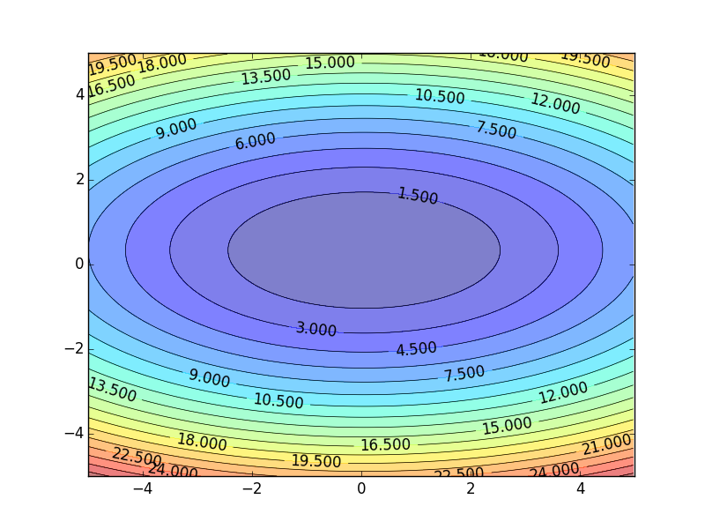
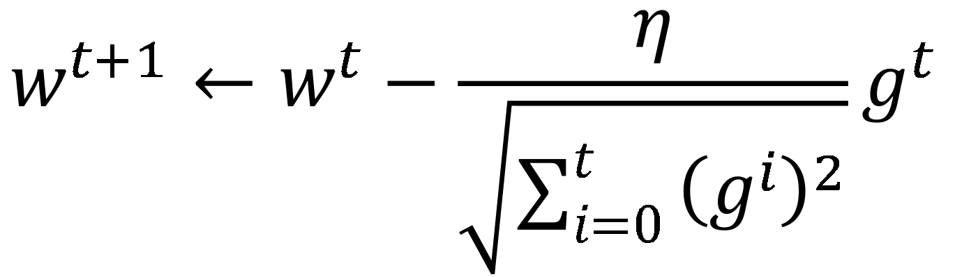
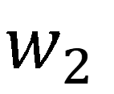
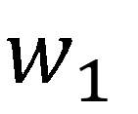
Review
Smaller Learning Rate
$$w_{2}$$
Larger Learning Rate
Adagrad
$$w_{1}$$
$$w^{t+1}←w^{t}−\frac{η}{\sqrt{\sum_{i=0}^{t}{{\left(g^{i}\right)}^{2}}}}g^{t}$$
Use first derivative to estimate second derivative

Slide 4
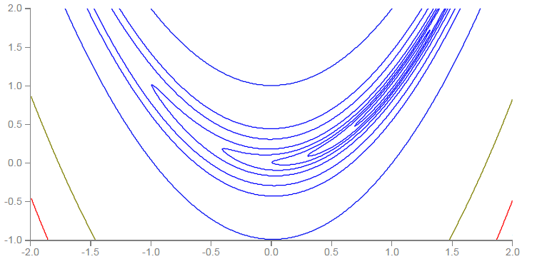
RMSProp
Error Surface can be very complex when training NN.
Smaller Learning Rate
$$w_{2}$$
Larger Learning Rate
$$w_{1}$$

Slide 5
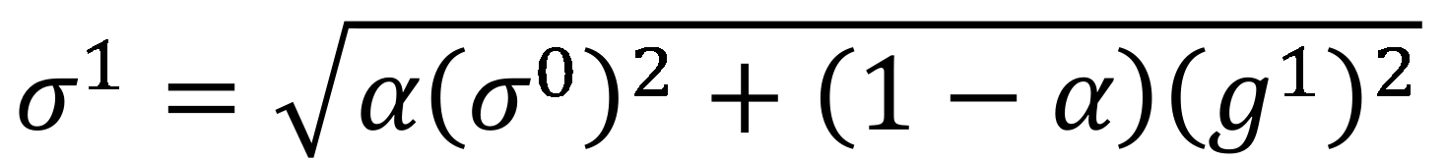
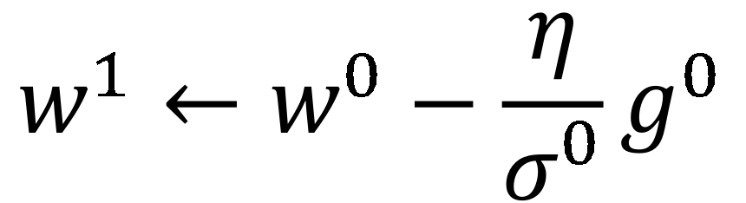
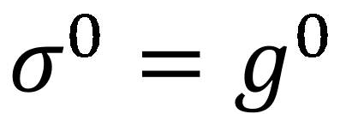
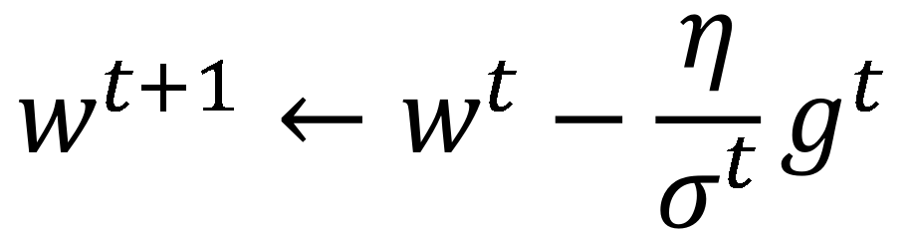
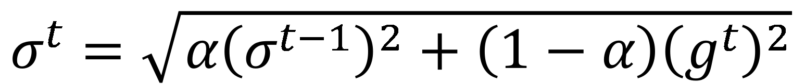
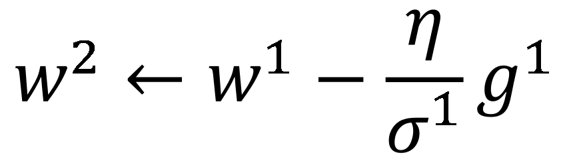
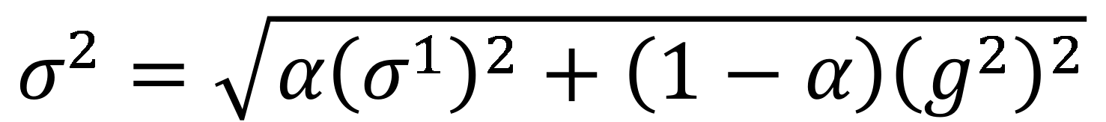
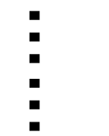
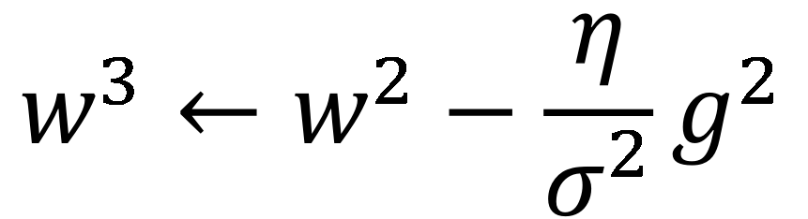
RMSProp
$$w^{1}←w^{0}−\frac{η}{σ^{0}}g^{0}$$
$$σ^{0}=g^{0}$$
$$w^{2}←w^{1}−\frac{η}{σ^{1}}g^{1}$$
$$σ^{1}=\sqrt{{α\left(σ^{0}\right)}^{2}+\left(1−α\right){\left(g^{1}\right)}^{2}}$$
$$w^{3}←w^{2}−\frac{η}{σ^{2}}g^{2}$$
$$σ^{2}=\sqrt{{α\left(σ^{1}\right)}^{2}+\left(1−α\right){\left(g^{2}\right)}^{2}}$$
$$……$$
$$w^{t+1}←w^{t}−\frac{η}{σ^{t}}g^{t}$$
$$σ^{t}=\sqrt{{α\left(σ^{t−1}\right)}^{2}+\left(1−α\right){\left(g^{t}\right)}^{2}}$$
Root Mean Square of the gradients with previous gradients being decayed

Slide 6



Hard to find optimal network parameters
Total
Loss
Very slow at the plateau
Stuck at saddle point
Stuck at local minima
$$∂L∕∂w$$
$$≈0$$
$$∂L∕∂w$$
$$=0$$
$$∂L∕∂w$$
$$=0$$
The value of a network parameter w

Slide 7
In physical world ……
Momentum
How about put this phenomenon in gradient descent?

